Slide 1


HIV Research @ the
San Francisco Dept. of Public Health
AIDS Office

Slide 2
SFDPH AIDS Office
Bridge HIV
Center for Public Health Research
Applied Research, Community Health Epidemiology, and Research (ARCHES)
Community Health Equity and Promotion
HIV Care
Notes:
Created in 1987
Combined surveillance, a research cohort, and prevention/community partnerships

Slide 3

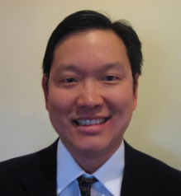

Bridge HIV: A Tradition of Innovative Research to Prevent HIV/AIDS
SF City Clinic Cohort Study
- HIV antibody test
- Natural history
- Long term non-progression (LTNP)
Vaccine Preparedness Studies
- Recruitment and retention of at-risk cohorts
- Risk factors for infection
- Per-contact risk
Behavioral and Biomedical Interventions
- Individualized, client centered counseling
- Preventive Vaccines*
- STD interventions (HSV-2 suppression)
- Pre-exposure Prophylaxis*
- Rectal and vaginal microbicides*
- Peer navigation among Black and Latino MSM*
- Home HIV and STI testing*
Evaluating Platforms for Intervention Delivery and Building Research Capacity
- Combination Prevention*
- Implementation Research*
- Fostering a new generation of HIV researchers*
Hyman Scott,
MD, MPH
Susan Buchbinder, MD
Albert Liu, MD, MPH
*Active studies

Slide 4


Next generation of PrEP Research
HPTN 069, 077
Evaluate safety and tolerability of Maraviroc (CCR5 inhibitor)GSK744-LA long-acting injectable (integrase inhibitor)
MTN 017, 028
Evaluate safety, acceptability , PK of
Rectal TFV gel (daily, pre/post anal sex)
Vaginal ring (MK-4176 CCR5 inhibitor and MK-2048 integrase inhibitor)
DOT-DBS
Help develop novel methods to measure HIV medications in people’s bodies.
Dried blood spots and hair samples can be used as a tool to accurately measure how often people take their PrEP pills
EPIC (NIMH R01, completed)
Develop and evaluate novel adherence strategies to support PrEP (SMS, integrated counseling)
iPrEx OLE, completed
Offer open-label Truvada to iPrEx RCT ppts to evaluate uptake, adherence, risk practices
PrEP Cascade
Measure PrIDE Project via surveillance of community PrEP awareness, knowledge, access, uptake, and adherence, the key steps in the PrEP cascade

Slide 5


Substance Use Research Unit (CPHR)
Ongoing Trials and Observational Studies
Phillip Coffin, MD
Glenn-Milo Santos, PhD
 | REBOOT | COPING | Transitions
Population & Setting | Opioid users (N=63) | People prescribed opioids (N= 300-400) | People prescribed opioids (N= 600)
Intervention | Counseling v. SOC | Observational | Observational
Primary outcome | Overdose events | Pain and function | Illicit opioid use
Design | RCT, 16m f/u | Longitudinal cohort, up to 4yr f/u | Longitudinal, retrospective cohort
Notes:
We are currently finishing up REBOOT which is a randomized trial of a counseling interventions to reducing incidence of overdose events among opioid users with a history of overdose. Data collection should be completed by end of December 2016
COPING is a longitudinal cohort that will enroll up to 400 participants currently or recently prescribed opioids long-term for chronic non-cancer pain. This is an observational study the collect data on overdose among patients prescribed opioids to answer how prescribing practices impact patient health outcomes and risk for overdose.
Transitions is a longitudinal, retrospective cohort that will enroll 600 patients prescribed opioid pain relievers chronically for non-cancer pain. It will look at opioid overdose among patients who use OPRs for pain and will also look at the decline in access to OPRs prescribed for chronic pain.

Slide 6


Substance Use Research Unit
Ongoing Randomized Intervention Trials
 | Bye-C | Say When | M2.0
Population | People who inject drugs (N=30) | Binge-drinking MSM (N=120) | Meth-dependent MSM (N=120)
Intervention & Control | Modified directly observed treatment (mDOT) of HEP-C tx | Oral naltrexone vs. placebo, as-needed | Oral mirtazapine vs. placebo
Outcome | Adherence | Alcohol Use, Sexual Risk Behaviors | Meth Use and Sexual Risk Behaviors
Design | RCT, 8 week f/u | Double-blind RCT, 3 month f/u | Double-blind RCT, 9 month f/u
Notes:
BYE-C (Coffin)- This is a pilot study that will assess the feasibility and acceptability of treating active people who inject drugs (PWID) for HCV. Participants are randomized to either the mDOT arm or unobserved dosing arm.
Say When(Santos) – This study will evaluate the efficacy of taking oral naltrexone in reducing alcohol use and alcohol-associated risk behaviors among non-dependent, binge-drinking MSM at risk for acquiring or transmitting HIV. Participants in the trial will take the medication on an as-needed basis in anticipation of drinking.
M2.0 (R01) (Coffin) –To test if oral mirtazapine, an antidepressant with serotonergic and dopaminergic properties, vs. placebo significantly reduces meth use and HIV sexual risk behaviors among actively- using meth-dependent MSM from 0-12 weeks of treatment. Participants in both arms will receive the behavioral platform of in-person weekly substance use and monthly brief adherence counseling, augmented by daily text messaging adherence reminders.

Slide 7

HIV Epidemiology Research
Henry Raymond, DrPH
National HIV Behavioral Surveillance
SF arm of CDC’s National HIV Behavioral Surveillance
Ongoing research into HIV prevalence, incidence, and HIV risk behaviors among populations at high risk for HIV in SF
Rotating annual cycles:
  MSM,
  PWID,
  Trans women,
  Heterosexuals at risk for HIV infection

Slide 8
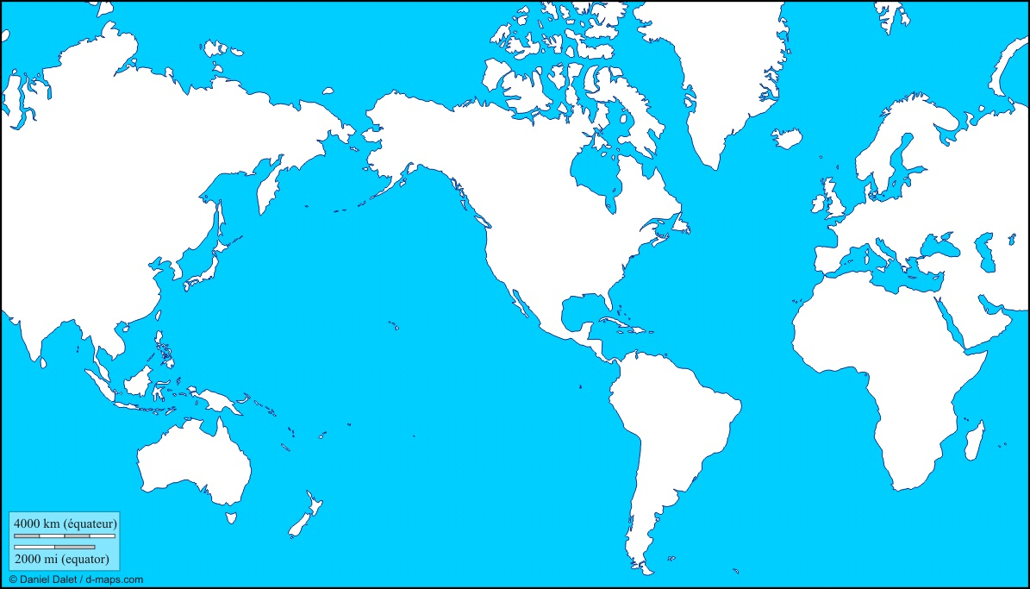

































Substance Use Research Unit
Ongoing Feasibility and Evaluation Studies
Phillip Coffin, MD, MIA
Glenn-Milo Santos, PhDc, MPH
Russia: Naloxone to heroin users for overdose
Kazakhstan: Estimating the number of MSM, IDU, FSW
 | NIP | NOSE | Naloxone Pre/Post-test
Population & Setting | alcohol-dependent High Users of Multiple Systems (HUMS) clients of SFDPH (N=10) | patients on chronic opioids from primary care clinics (N=6 clinics) | naloxone recipients from the Drug Overdose Prevention & Education (DOPE) Project (N=60-100)
Intervention | Intramuscular naltrexone | naloxone | Brief naloxone training
Outcome | urge to drink, medical services utilization | naloxone uptake, naloxone acceptability | Brief Overdose Recognition & Response Assessment (BORRA), knowledge of overdose and naloxone use
Serbia: Reaching Roma youth
China: Promoting testing, linkage to care, and navigation in care for MSM
Multiple African countries: HIV prevention for vulnerable populations
Iran: Assessing HIV risk in street children
Myanmar: Promotion of community health workers to deliver diarrhea and malaria treatment
Guyana: Helping to establish a new school of public health
Australia: Sampling fishers to identify over-fishing
Brazil: Promoting testing, linkage to care, and navigation in care for MSM

Slide 9




Erin C. Wilson, DrPH
Sean
Arayasirikul, MPH
Longitudinal study of young transwomen aged 16-24 years
Study of HIV risk and resilience
300 participants recruited
www.theshinestudy.org

Slide 10
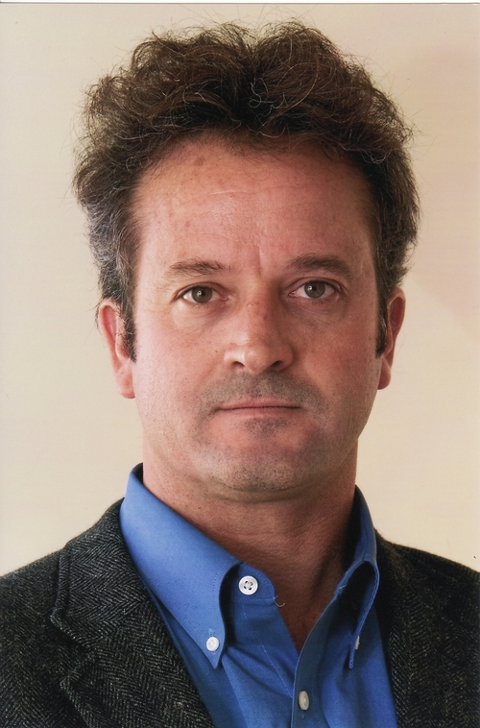




Slide 11

Bridge HIV & CPHR collaborative studies

Slide 12
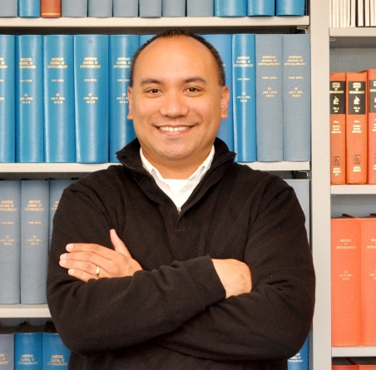

Applied Research, Community Health Epidemiology, and Surveillance (ARCHES)
Wayne Enanoria, PhD, MPH
Susan Scheer, PhD, MPH
ARCHES is an integrated center for Public Health surveillance, epidemiology, applied research, and program science
Core HIV/AIDS Surveillance
HIV Incidence Surveillance
Molecular HIV Surveillance
Medical Monitoring Project
Provide Metrics to Monitor Success of all Getting to Zero Strategic Initiatives

Slide 13
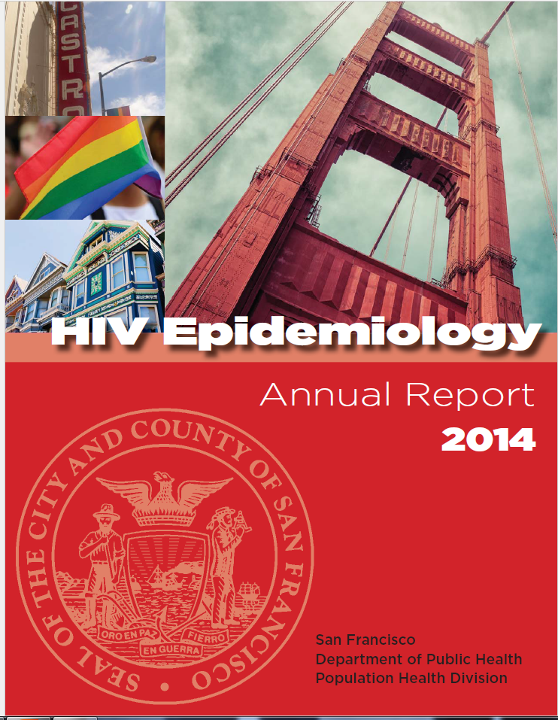
ARCHES –HIV Surveillance
Monitor incidence, prevalence, morbidity and mortality of persons with HIV/AIDS in San Francisco, following government mandates
AIDS case reporting since 1981, HIV case reporting since 2002
Longitudinal registry
  Follow-up chart reviews for ART, prophylaxis, OIs
  Follow-up CD4 and viral loads
  Deaths and multiple causes of death
Notes:
Provide critical data to monitor current/emerging trends in HIV transmission, characterize recent infections, and target prevention resources

