Slide 1
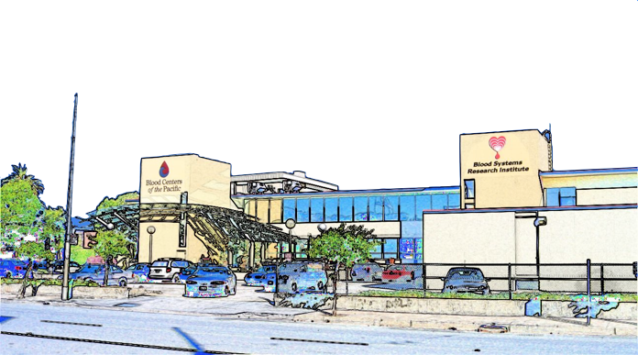
Intro to Blood Systems Research Institute (BSRI)
Satish K. Pillai, Ph.D.
Associate Investigator, BSRI
Associate Professor of Laboratory Medicine, UCSF

Slide 2
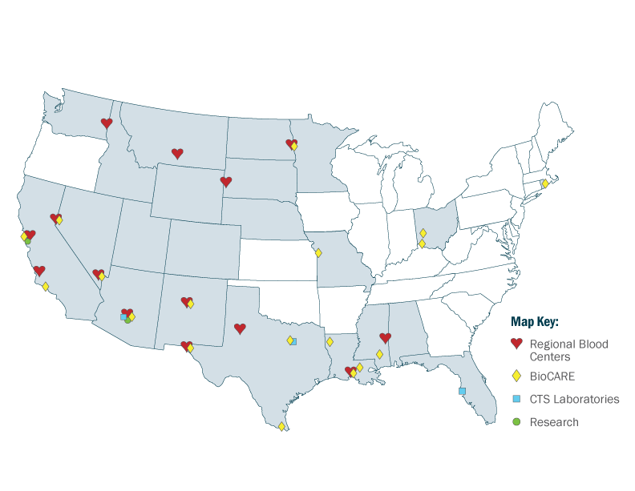
Blood Systems
10 Regional Blood Centers serving 18 States
Research Institute in SF (BSRI), plus R & D in Medical Affairs and at CTS Tempe lab
Blood Systems is dedicated to continuous performance improvement, and regular implementation of new quality initiatives to ensure positive outcomes for donors/patients
Notes:
We are a non-profit organization serving 18 states.

Slide 3
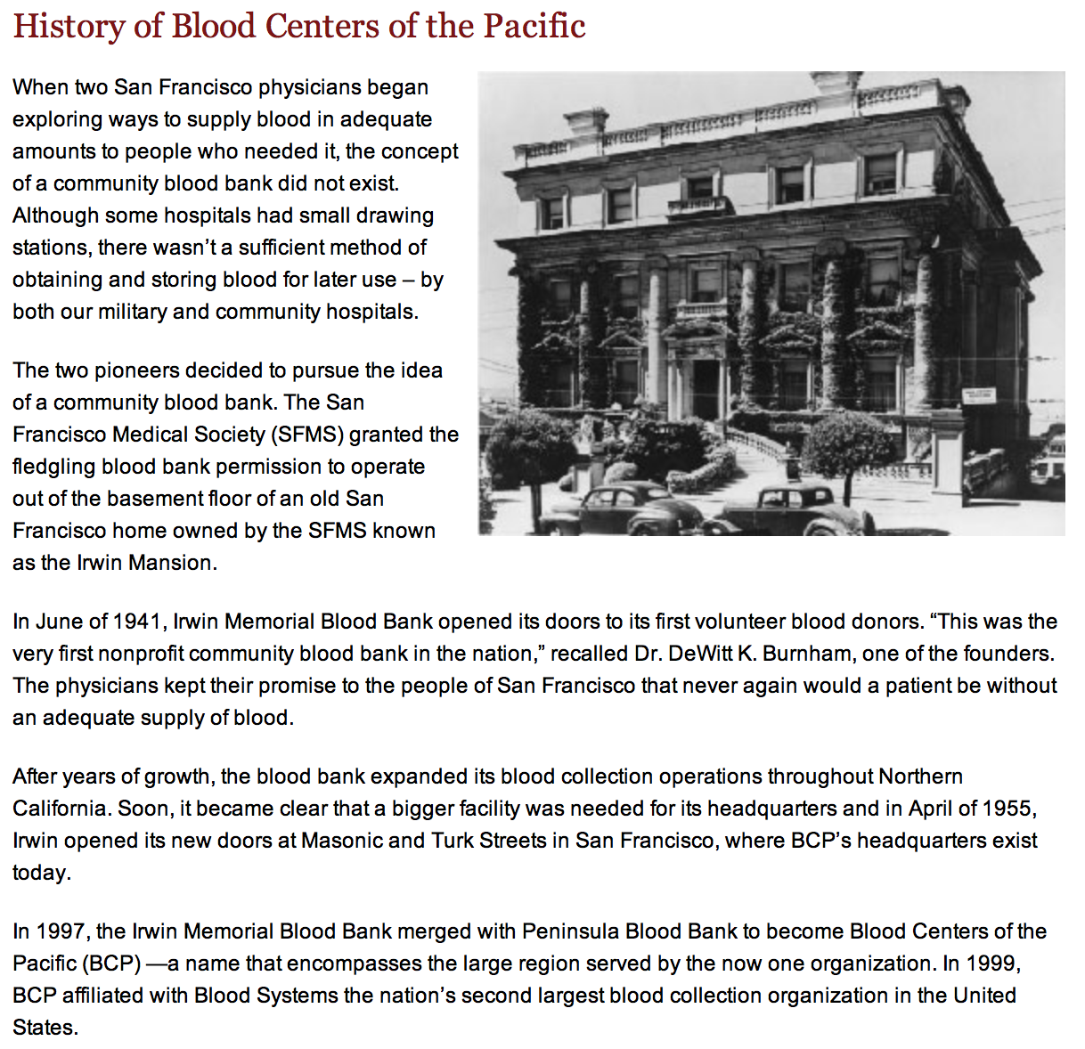

Slide 4
BSRI Mission
BSRI is dedicated to advancing blood safety world-wide through scientific research, education and the promotion of evidence-based policies.
BSRI Vision
BSRI, an integral part of BSI, is a premier transfusion medicine research institute in the US focused on scientific and policy advances relevant to transfusion and cellular therapy, with particular focus on mechanisms underlying and prevention of infectious and immunological complications of transfusions. BSRI contributes to and engages other BSI divisions and CTS in research, policy and test development and application of new evidence-based practices.

Slide 5


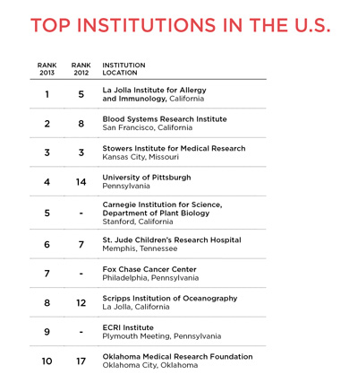
BSRI #2 on The Scientist’s 11th Annual
Best Places to Work in Academia
“Everything is related to blood transfusion, but there is virology, epidemiology, immunology,” says Rachael Jackman, a staff scientist at the institute. “You get to look at a problem from a lot of different angles.”
The institute benefits from its close alliance and shared location with a Blood Systems-owned blood bank—a valuable source of expertise. When Jackman was setting up a mouse model to study transfusions following traumatic blood loss, for example, she sought advice from technicians at the blood bank on preparing the blood transfer. “You can read about it, but it’s much more helpful to go downstairs and talk to people who are doing the processing,” she says.
The blood bank also serves as a daily illustration of the real-world implications of the BSRI scientists’ work. “It kind of reminds you that there is a real, practical purpose to our research, which is maintaining the safety and availability of blood,” says Eric Delwart, a senior investigator at BSRI. “It’s a neat little place: good funding, great town, great science.”

Slide 6
BSRI Today
Principal Investigators
Michael Busch, MD, PhD – virology, clinical pathology, transfusion medicine
Edward Murphy, MD, MPH – epidemiology, HTLV, HCV, International Training
Brian Custer, PhD – epidemiology, health policy
Eric Delwart, PhD – molecular virology, HIV, HCV, WNV
Philip Norris, MD – cellular immunity, HIV, WNV, MC
Graham Simmons, PhD – virus-cell interactions, emerging infections
Mark Seielstad, PhD – genetic epidemiology of infectious and immune disease
Shibani Pati, MD, PhD – mechanisms of transfusion and cellular therapy in trauma and TBI
Satish Pillai, PhD – molecular evolution and pathogenesis of HIV-1
Clinical Investigators
Evan Bloch, MD – maternal fetal transfusion, International blood safety
Shannon Kelly, MD – pediatric hematology, clinical outcomes and transfusion support of SCD
Thelma Goncalez, MD – studies in Brazil
Nareg Roubinian, MD – recipient outcomes following blood transfusion
Visiting Scientists
Dan Capon, PhD – protein chemistry, humanized antibodies
Core Scientists
Mars Stone, PhD – HCV, WNV, repositories Viral Ref Lab & Repos
Tzong-Hae Lee, MD, PhD – molecular biology, MC Molecular TM
Marcus Muench, PhD – cellular therapy Cellular Therapy/Vivarium
Anne Guiltinan, MA, Roberta Bruhn, PhD Epidemiology
Tung Phan, PhD – molecular biology Molecular Virology
Sheila Keating, PhD – immunology, virology Immunology
Sherri Cyrus/Joan Dunn-Williams CTS Molec Dx Lab
Staff ~34 technologists, 7 post-docs
Administration – JoAnn Yates and 8 admin staff
Affiliate Investigators
Charles Chiu, MD, PhD – UCSF / Abbott Viral Diagnostics and Discovery Center
Steve Kleinman, MD – Kleinman Biomedical Research (Victoria BC)
Nico Lelie, PhD – Lelie Research (Paris, FRANCE)
Willi McFarland, MD, PhD, MPH & TM – SFDPH
Kim Nguyen, PhD – Terumo BCT
Ester Sabino, MD, PhD – FFM (Sao Paulo, BRAZIL)
Philip Spinella, MD – Washington U. of St. Louis
Phillip Williamson, PhD – CTS

Slide 8
BSRI Publication Output

Slide 9
Areas where BSRI research has impacted policy formulation in TM
Infectious Diseases
NAT screening options: Novartis vs Roche; MP vs ID; HBV
HIV and HCV pathogenesis
WNV pathogenesis and screening (triggering) strategies
Chagas screening: targeted screening strategies; follow-up studies to guide donor counseling
Parvo B19 – donor screening vs in process testing of recovered plasma
Dengue, Chikungunya and other arboviruses
New potential TTVs: discovery (metagenomics) and appropriate responses
Pathogen reduction: CE, efficacy for IDs and WBC
XMRV

Slide 10
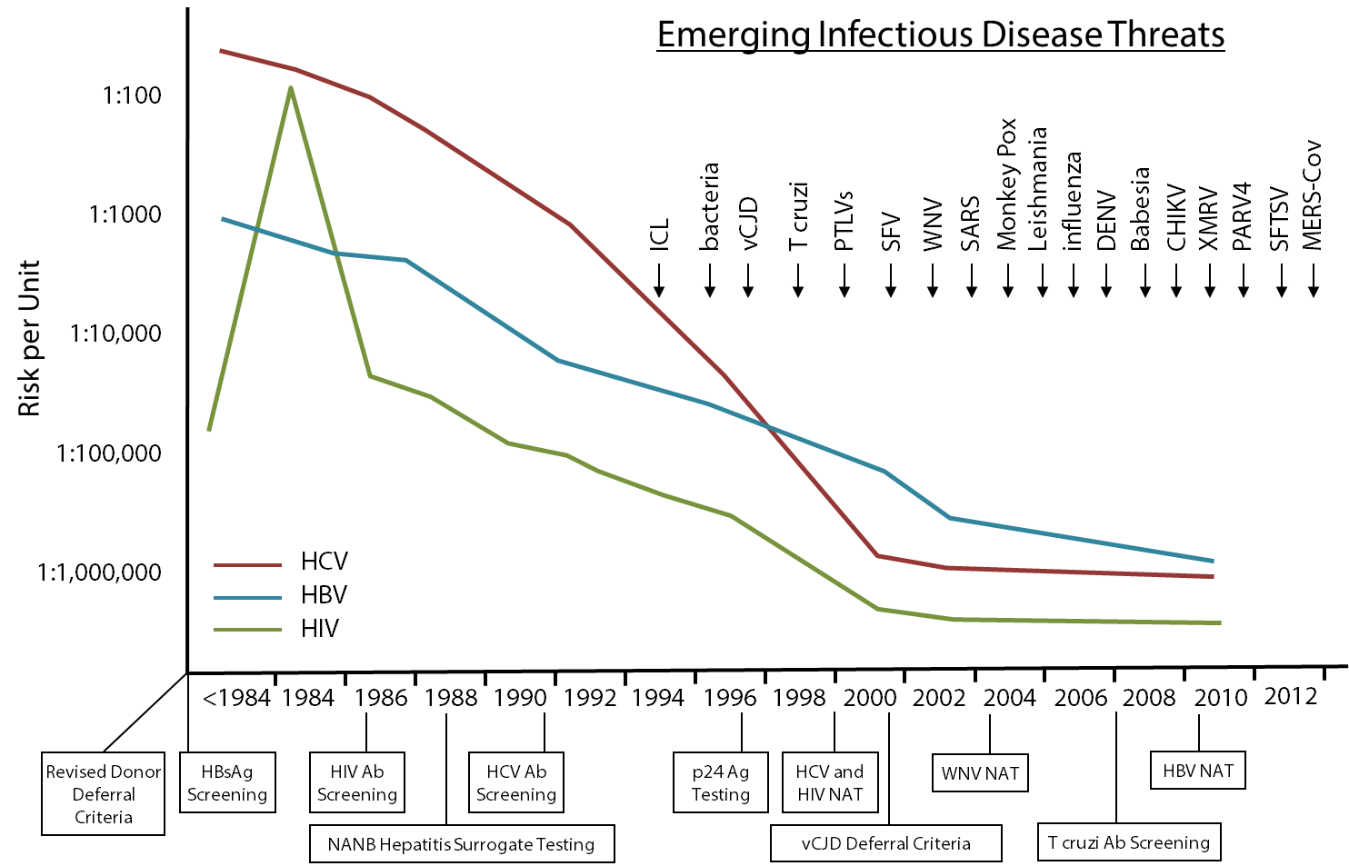
Risks of major TTVs linked to interventions, and accelerating rate of EIDs of concern to blood safety

Slide 11

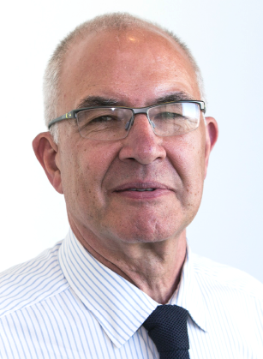
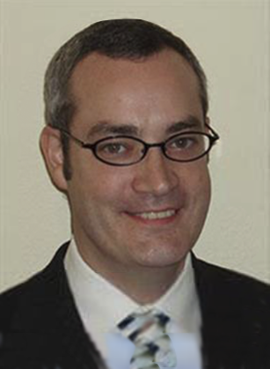
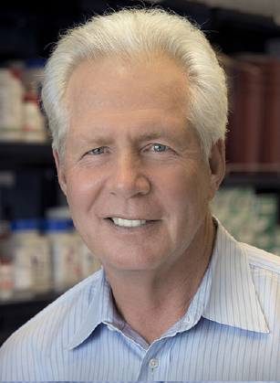
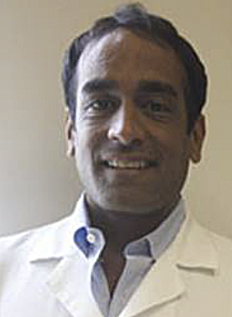
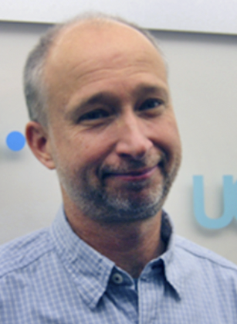
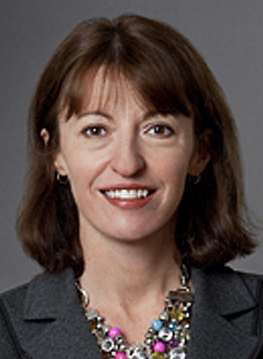



Goal: Scientific foundation for a cure by 2020
How: Invest $20 million, 5 years
Warner Greene
Understanding
Paul Volberding
Principal
Investigator
Peter Hunt
Charting
Satish Pillai
Recording
Steve Deeks
Eliminating
Rowena Johnston
amfAR

Slide 12

HIV Reservoir Assay Validation and Evaluation Network (RAVEN)
The Gates Foundation has invested $4.5M into the RAVEN program (led by M. Busch) to develop and standardize HIV reservoir assays
In addition to extensive blood-based characterization, RAVEN participants will be prospectively recruited to collect a wide range of tissue biopsies
The amfAR Institute for HIV Cure Research will heavily leverage RAVEN resources

Slide 13
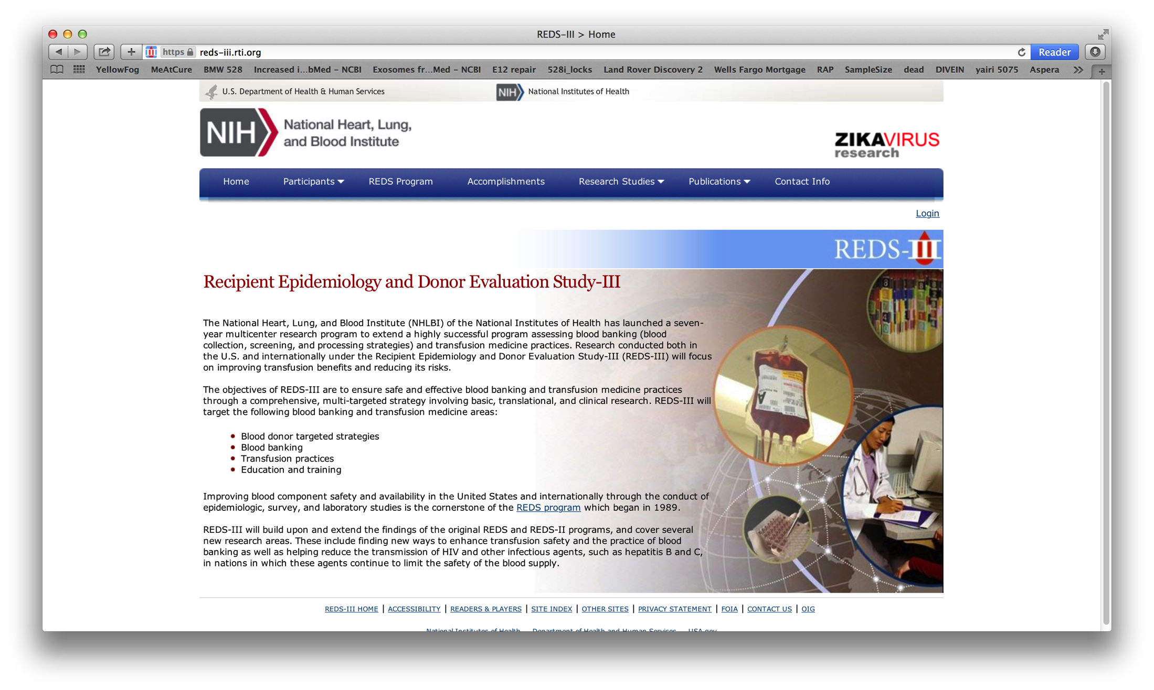

Slide 14
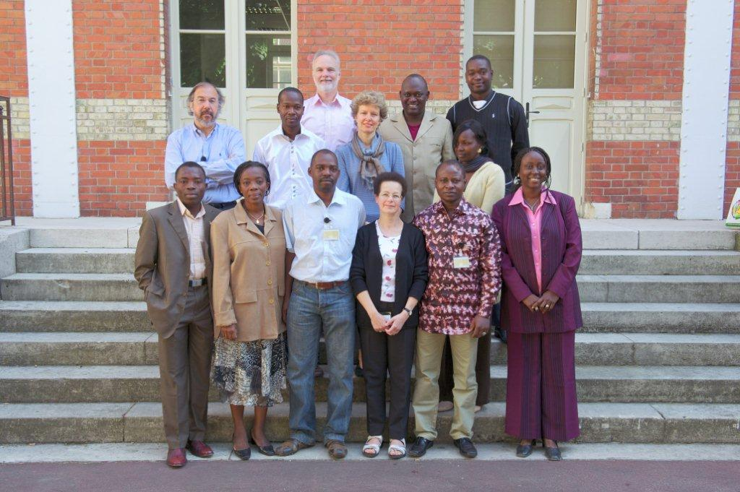
Training in Clinical Research – Global TM
Leadership: Dr. Edward L. Murphy
Age of program: 7 years
Location: Latin America, Paris (for francophone Africa) and South Africa
Funding sources: BSRI, ISBT, UCSF Center for AIDS Research
Goals: Educate international scientists and physician-scientists in TM clinical research methods. Leverage research relationships for BSI/BSRI research projects. Visible leadership role for BSI/BSRI
Assessment metrics:
Number of trainees and their career paths
Scientific publications and presentations
Extramural funding
Course evaluations by trainees

Slide 15
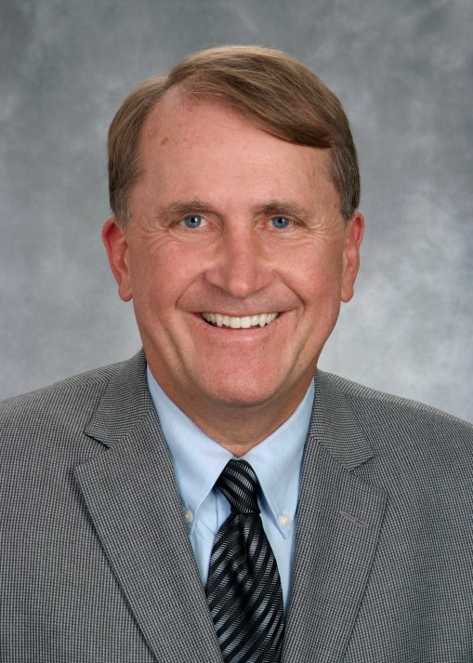
Michael Busch
Director and Senior Investigator, BSRI
Research Areas
Virology and pathogenesis (HIV, HCV, WNV)
Transfusion safety
Viral dynamics of acute viral infection
Viral testing (antibody and nucleic acid identification)
Translational epidemiology/specimen repository generation
Microchimerism (persistence of donor cells long after transfusion),
mechanisms of immune tolerance in transfusion recipients

Slide 16
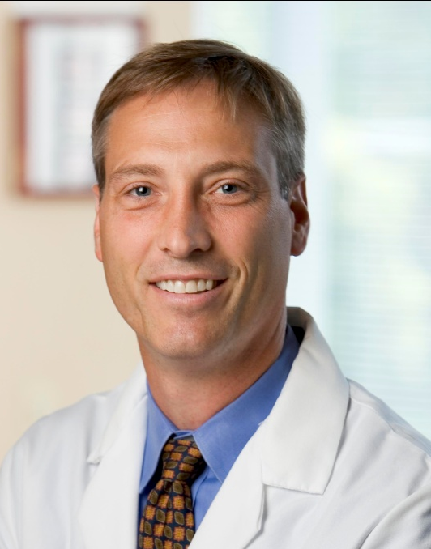
Philip Norris
Director and Senior Investigator, BSRI
Research Areas
Viral immunology (HIV, WNV)
Transfusion immunology
HIV pathogenesis, focus on CD4+ T cell effector function
West Nile virus (WNV), role of regulatory and effetor cells in pathogenesis
Acute viral infections, characterization of early cytokine responses
Mechanisms of immune tolerance in transfusion recipients
Characterization of signaling pathways of extracellular vesicles

Slide 17
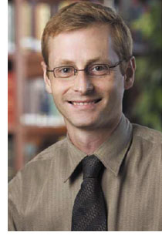
Brian Custer
Associate Director and Senior Investigator, BSRI
Research Areas
Epidemiology
Health Policy Research
Infectious disease epidemiology in blood donors
Cost-effectiveness of blood safety interventions
Identification of risk factors for adverse donor reactions (vaso-vagal and needle-related injuries)
Blood utilization and recipient outcomes

Slide 18
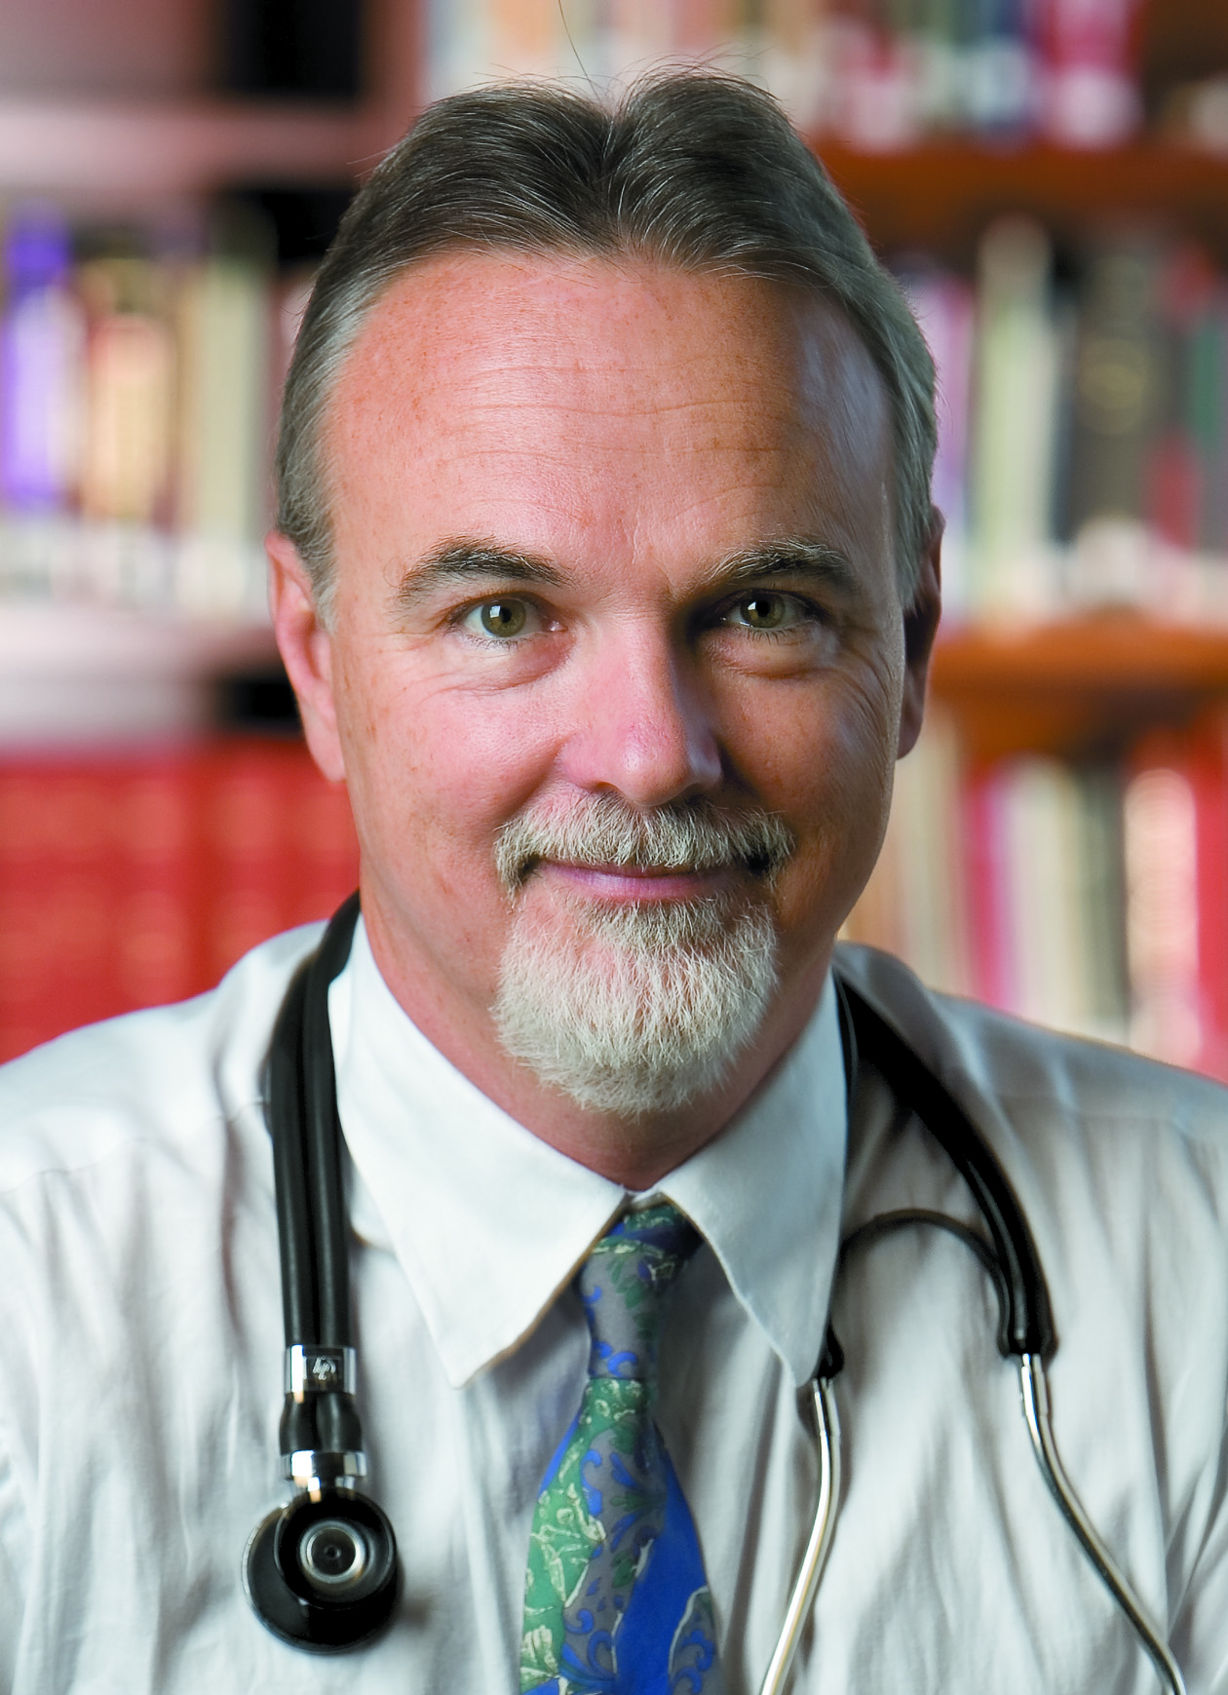
Edward L. Murphy
Professor, UCSF and
Senior Investigator and
Education Director, BSRI
Research Areas
Transfusion Epidemiology
Global transfusion safety
Viral epidemiology (HTLV, HCV, HIV)
Transfusion epidemiology, including studies of blood donors and health outcomes among blood recipients. PI of REDS-III Domestic center at UCSF and BSRI.
Global transfusion research - PI of the REDS-III International center with South African National Blood Service.
Epidemiology and pathogenesis of HTLV-I and HTLV-II, Hepatitis C virus and HIV.
Training in Clinical Research (TICR) directed at blood bankers in low- and middle-income countries.

Slide 19
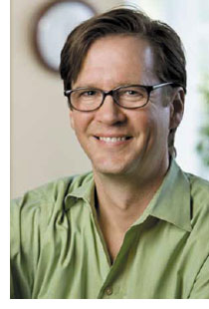

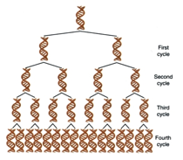


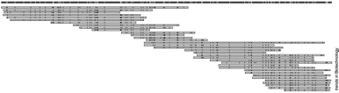




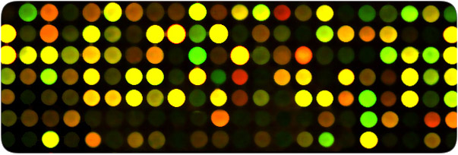

Eric Delwart
Senior Investigator, BSRI
Research Areas
Viral metagenomics
RNA virus evolution
Viral discovery in enteric and respiratory diseases and cancer.
Development of antibody assays to measure exposure to newly identified viruses.
Evolution of HIV-HCV-WNV.
SAMPLES & SEQ GENERATION
GENETIC ANALYSES
EPIDEMIOLOGY
PCR &
microarray
detection
Enrich
viruses
De novo
assembly

Slide 20
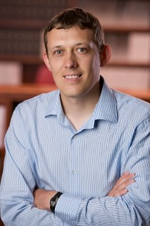
Graham Simmons
Assistant Investigator, BSRI
Research Areas
Viral biology
Viral entry
Mechanisms of enveloped virus entry and release
Antibodies and small molecule inhibitors of viral entry
Emerging human viruses – Ebolavirus, MERS coronavirus and Chikungunya virus

Slide 21
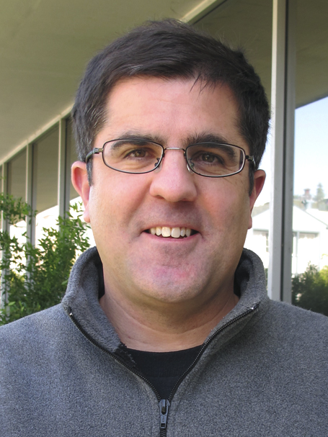
Mark Seielstad
Associate Professor, UCSF
Associate Investigator, BSRI
Research Areas
Genetic Epidemiology
Population Genetics
Susceptiblity to infectious diseases
Genetics of autoimmunity and alloimmunization in blood donors and recipients
Genetics of Type 2 Diabetes and metabolism
Anthropological Genetics of Human Populations

Slide 22
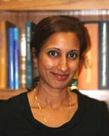
Shibani Pati
Associate Investigator, BSRI
Research Areas
Translational Stem Cell Therapeutics
Vascular Biology
Blood Products in Traumatic Injury
Therapeutic use of Bone Marrow derived Stem cells for cerebral edema and cognitive dysfunction in Traumatic Brain Injury (TBI)
Therapeutic use of Bone Marrow derived mesenchymal stem cells for Acute Lung Injury (ALI) in trauma
Effects of FFP and storage of FFP on vascular stability and hemostatic function in hemorrhagic shock and trauma.
Modulators of Vascular Stability in Injury: Small Molecules and Soluble Factors

Slide 23
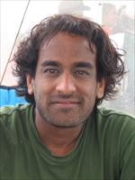
Satish Pillai
Associate Investigator, BSRI
Research Areas
Molecular Evolution
Viral Pathogenesis
Viral genetic determinants of HIV/AIDS pathogenesis and transmission
Molecular evolution of HIV-1 in the central nervous system
Effects of interferon-induced host restriction factors on retroviral replication
Effects of host genetic variation on the HIV-1 latent reservoir
Estimation of HIV-1 incidence using novel biomarkers

Slide 24
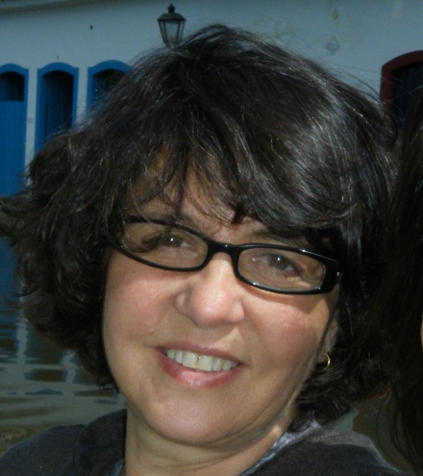
Thelma Goncalez
Associate Clinical Investigator, BSRI
Research Areas
Epidemiology
Transfusion safety
• Donor and recipient epidemiologic studies focusing on transfusion
transmitted diseases.
• Donor behavioral studies: Test-Seeking, Motivation and Sexual
Behaviors.
• Blood transfusion and blood utilization and patient outcomes.
• Epidemiological studies focusing on HIV positive donors.

Slide 25
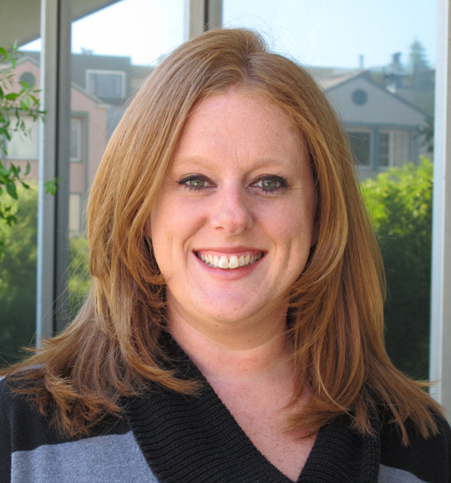
Shannon Kelly
Assistant Clinical Investigator, BSRI
Research Areas
Pediatric transfusion medicine
Impact of transfusion in sickle cell anemia
Development of a comprehensive database of clinical, laboratory and transfusion information and biospecimen repository for sickle cell patients in Brazil
Characterization of immune modulation and changes in mRNA expression which occur after transfusion in sickle cell anemia
Identification of single nucleotide polymorphisms that contribute to the risk of red blood cell alloimmunization in sickle cell anemia
Erythrocytapheresis in chronically transfused pediatric patients with sickle cell anemia

Slide 26
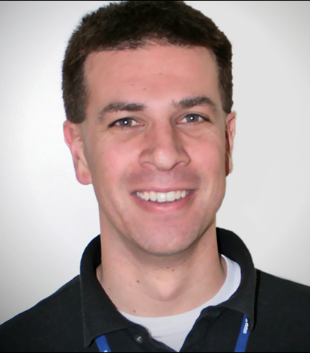
Nareg Roubinian
Assistant Clinical Investigator, BSRI
Research Areas
Transfusion Recipient Outcomes
Pulmonary Transfusion Reactions
Predictive models and trends in blood utilization and associated transfusion recipient outcomes
Clinical and laboratory factors in blood donors, components, and recipients relevant to the efficacy as well as the potential harm (e.g., pulmonary transfusion reactions) of blood transfusion.

Slide 27
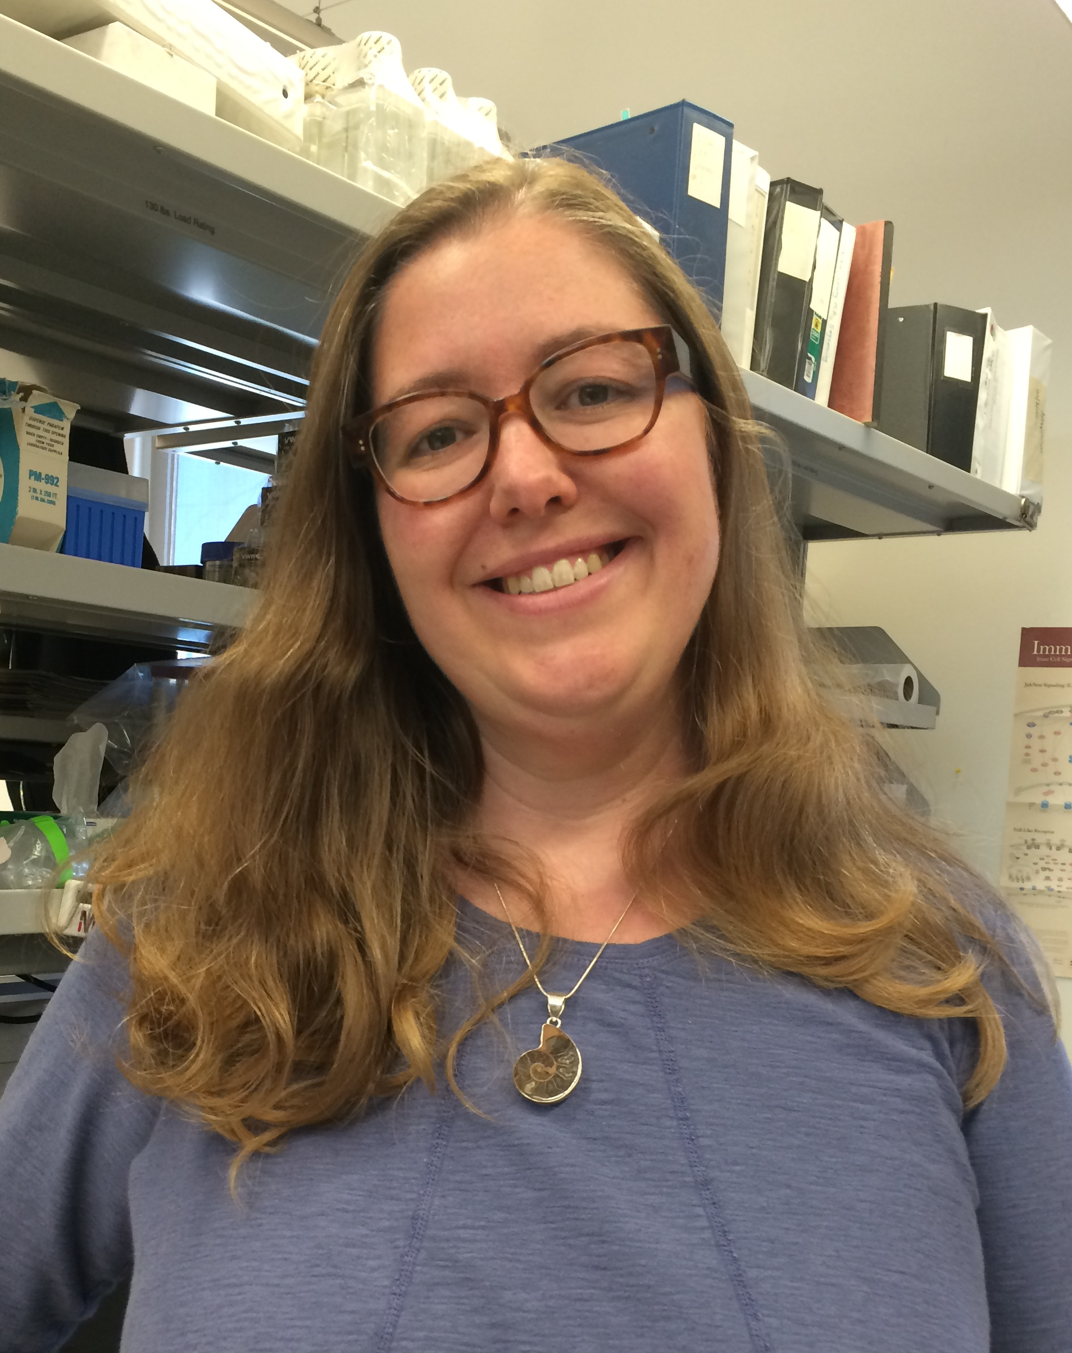
Rachael Jackman
Assistant Investigator, BSRI
Research Areas
Transfusion Immunology
Alloimmunization
Alloimmunization and tolerance
Pathogen reduction and the immune response to blood transfusion
Immune modulation associated with blood transfusion and traumatic injury

Slide 28
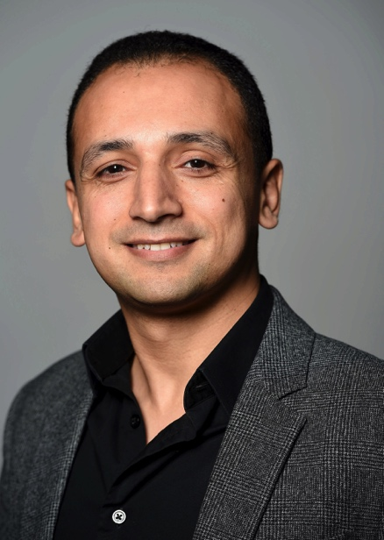
Mohamed Abdel-Mohsen
Assistant Investigator, BSRI
Research Areas
Glycoimmunology
Host-virus interactions
Persistence and Immunopathogenesis of HIV Infection
Multidisciplinary studies at the interface of Immunology, Virology, Molecular biology, and Glycobiology
Role of glycan-lectin interactions in mediating cellular processes central to immune regulation and human diseases
Role of altered cell-surface glycosylation in defining disease states, and exploiting the information for development of diagnostic and therapeutic approaches
Multi-omics approach to study host response to viral infections, emphasizing HIV
Development and implementation of robust and sensitive assays to measure cellular and tissue HIV reservoirs

