Slide 1
DEFINITIONS OF MENTORING UCSF-GIVI CFAR MENTORING PROGRAM OCTOBER 23, 2015
Monica Gandhi MD MPH and Jonathan Fuchs MD MPH
Co-directors, CFAR Mentoring Program

Slide 2
Outline
What is a mentor?
Attributes of successful mentors, mentees
The mentee-mentor relationship
What works and what does not?
Formalizing the mentoring relationship
Mentoring for diversity
Mentoring training programs

Slide 3
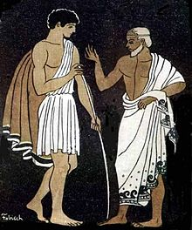
Telemachus and “Mentor”
When Odysseus left for the Trojan War, the older “Mentor” was put in charge of Telemachus, Odysseus’ son

Slide 4
What is a mentor?
COACH
CONSULTANT
ADVISOR
MANAGER
TEACHER
COUNSELOR
GUIDE
ROLE MODEL
Notes:
How many mentors? Mentees? Both?
One word or phrase that categorizes a mentor or a mentoring relationship

Slide 5
Scope of mentoring
Career functions
Sponsorship
Coaching
Protection
Challenge
Exposure and visibility
Personal functions
Role modeling
Problem solving and counseling
Acceptance and affirmation
Kram, KE. Mentoring at Work: Developmental Relationships in Organizational Life. 1988
Notes:
Sponsorship: mentor opens doors that would otherwise be closed
Coaching: the mentor teaches and provides feedback
Protection: supports protégé and/or acts as a buffer
Challenge: the mentor encourages new ways of thinking and acting and pushes the protégé to stretch her capabilities
Exposure and visibility: steer protégé into assignments that increase recognition within the organization
Role modeling; mentor demonstrates the kinds of behaviors, attitudes and values that lead to success in the profession
Counseling: helps protégé deal with difficult professional dilemmas.
Acceptance/Confirmation: supports the protégé and shows respect

Slide 6
Mentoring content areas - traditional
Research skills
Research methods
Ethics & IRBs
Manuscript writing and publishing
Grant writing
Budgets and administration
Career goals
CV development
Professional networking
Organization and committee participation
Promotion/tenure

Slide 7
Mentoring content areas – skills that we do not learn in school
Time management and maximizing productivity
Navigating work-life balance
Negotiating skills
How to hire great people
Managing performance reviews
Having crucial conversations/confrontations
Cross-cultural issues
Dissemination strategies
Working with relevant communities
Enabling mentee to navigate the professional community, including introductions to relevant researchers in the field
How to mentor

Slide 8
Mentoring team
Research mentor: Guides the development of the creative and/or independent research careers of their mentees. Must have expertise in the mentee’s area of scholarship and help provide resources to support the mentee’s work
Research
Co-mentor(s): Works with the mentee and research mentor to provide specialized content area or methodological expertise (e.g. qualitative mentor)
External (CFAR) career mentor: Assists with overall career guidance and support for their mentee. Is distant enough to troubleshoot issues with primary research mentors.

Slide 9
What are attributes of a good mentor?

Slide 10
What are attributes of a good mentor?
Goal-oriented
Credible, has specialized knowledge or expertise
Inspires excellence
Reveals aspects of their own personal journey
Honest and thoughtful
Trustworthy, reliable, and committed
Reinforces the importance of work-life balance
Promotes independence, which increases over time
Provides different and broader perspectives; can play the role of “devil’s advocate”
Allows the direction of the relationship to be defined by the mentee
Helps problem-solve by identifying the real issues and stumbling blocks that hinder research progress
Provides constructive feedback

Slide 11
What are attributes of a successful mentee?

Slide 12
What are attributes of a successful mentee?
Passionate about area of interest
Goal-oriented
Organized
Seeks to initiate new ideas
Accepts new challenges, willing to go beyond one’s comfort zone
Provides mentor status updates on activities and projects
Knows personal limits and when to ask for help
Communicates concerns with mentor
Seeks feedback and takes responsibility to give feedback to mentor
Respectful of mentor’s time and availability
Reassesses goals over time

Slide 13
The mentee-mentor relationship
Mentee + Mentor = Mentoring relationship

Slide 14
Mentoring relationships differ from other academic relationships
Long-term:
Promote professional development over time
Dynamic:
Change as mentee advances
Reciprocal:
Benefit both mentor and mentee
Active:
Shaped by mentee as well (mentee is not passive vessel)
Voluntary:
True mentoring relationship cannot be forced
Element of altruism
Zerzan JT. Academic Medicine 2009.

Slide 15
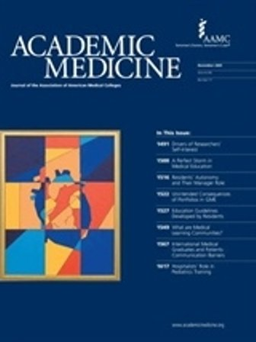
What works and what does not?

Slide 16
Characteristics of successful mentoring relationships
Theme | Responses
Reciprocity | “It’s got to be a 2-way street. It can’t be just a one-way giving relationship because then it’s going to burn out”
Mutual respect for each others’ time, effort, and qualifications | “Both individuals have to respect the qualifications of the other and the needs of the other and work together towards a common goal.”
Clear expectations Shared values Personal connection | “It’s helpful to set up guidelines in the beginning.” “Mentorship worked best when mentors and mentees had similar interests and values.” “Important to have a connection, where you feel the mentor cares about you.”
Straus SE. Academic Medicine 2013.

Slide 17
Characteristics of unsuccessful mentoring relationships
Theme | Responses
Poor communication Different expectations | Mentors frustrated when their advice not followed. Mentees feel intimidated. lack of open communication Mentee and mentor expect different things from the relationship: “recipe for disaster.”
Lack of commitment, lack of time, waning interest | “If you don’t get that kind of ongoing interest and commitment, you just realize that the fit or the value isn’t there anymore.”
Personality differences Perceived (or real) competition | One person is extraverted and the other introverted. One person thinks on the fly and the other likes to think ahead of time. Mentor may feel threatened. Both need credit. Lack of clarity around intellectual property.
Straus SE. Academic Medicine 2013.

Slide 18
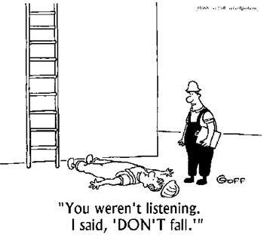
Mentee-driven relationship
The mentee cannot be passive!
Communicate what you want out of the relationship
Develop and communicate the plan for the year
Ask questions and listen
Anticipate problems and discuss them in a timely manner

Slide 19
Formalizing the relationship: The mentoring meeting with your primary mentor
Agree on the frequency of meetings
Approximately every 1-3 weeks
Mentees and mentors should come prepared
Mentee should send an agenda ≥2 days in advance
Include any other documents to be discussed
Mentee should formulate concise questions
After meeting, mentee emails a brief summary of what was discussed and next steps
Consider also keeping a document of notes from mentoring meetings for reference
Keep a running list of items for the next agenda

Slide 20
Resources from UCSF CTSI mentoring program https://accelerate.ucsf.edu/training/mdp-materials

Slide 21
Individual Development Plan and UCSF CFAR mentoring program
IDP
Help support, plan, and track your career development activities
Now required for NIH Research Performance Progress Reports
Update IDP and CV at least yearly for review in person
Important part of UCSF CFAR mentoring program
Monthly career development workshops
Yearly research symposium
Yearly leadership retreat
Linkage with senior HIV career mentor at UCSF for IDP review, quarterly meetings
Lightning rounds review of specific aims
Designated funding/ support for ESIs of diversity
Notes:
Tools of mentoring can be taught (like parenting) –

Slide 22
Individual Development Plan, UCSF CFAR Mentoring Program
1. Time allocation as estimated by mentee:
___ % Teaching/training/providing mentoring ___ % Research ___ % Patient care ___ % Administration/other services
How (if at all) would you like to change this time distribution?
2. Academic appointment
Do you understand the series to which you are appointed and the expectations for advancement in this series?
3. Current professional responsibilities
List your major professional responsibilities and if you anticipate significant changes in the coming year.
Notes:
Tools of mentoring can be taught (like parenting) –

Slide 23
Individual Development Plan, cont’d
4. Short-term professional goals List your professional goals for the coming year.
Indicate how you will assess if the goal was accomplished (outcome).
5. Long-term professional goals List your professional goals for the next 3-5 years.
Indicate how you will assess if the goal was accomplished (outcome).
1. Goal
Expected outcome:
2. Goal
Expected outcome:
3. Goal
Expected outcome:
1. Goal
Expected outcome:
2. Goal
Expected outcome:
3. Goal
Expected outcome:

Slide 24
Mentoring for diversity

Slide 25
NIH definitions of diversity
Racial/ethnic minorities:
Blacks or African Americans, Hispanics or Latinos, American Indians or Alaska Natives, Native Hawaiians and other Pacific Islanders
Individuals with disabilities:
Physical or mental impairment that substantially limits one or more major life activities
Disadvantaged backgrounds:
Annual income below established low-income thresholds
“Educational environment such as that found in certain rural or inner-city environments that has demonstrably and directly inhibited the individual from obtaining the knowledge, skills, and abilities necessary to develop and participate in a research career”
Women at senior faculty levels in biomedical-relevant disciplines
NIH institutes, centers, and offices may include women as eligible candidates in faculty-level, diversity-targeted programs to address faculty recruitment, appointment, retention or advancement

Slide 26
Black, Native American, and Hispanic Medical School Faculty: <10%
Percentage of U.S. Medical School Faculty by Race and Ethnicity, 2014
AAMC. U.S. Medical School Faculty Analysis, 2014.

Slide 27
Barriers to gender and ethnic/racial diversity
Pipeline
Support systems
Mentoring
Professional role models
Disparity in scientific identity and values
Unconscious bias
Pfund. Science 2006.
Koenig. Science 2009.

Slide 28
Mentoring the Mentors Training Programs, UCSF
Mentoring workshops for national HIV researchers
Recognizing need for formal training of mentors
Focusing on mentoring ESIs of diversity
September 2012, October 2013, May 2015
UCSF CFAR Mentoring Program – Program for ESI of diversity
Special career development workshops and peer support
Pilot funds for training, travel, conferences
Successful outcomes (4 of 8 in first cohort successfully applied for K award on first attempt)
International (Fogarty)

Slide 29
Mentoring workshop agenda: Focus on diversity
Definitions of mentoring
Definitions of diversity
Microaggressions, unconscious bias, “ton of feathers”
Diversity supplements, mentoring grants
Giving and receiving feedback
Crucial conversations
Mentor-mentee relationship
Individual development plans
Self-awareness in the mentoring relationship, leadership styles
Work-life balance
Time management for mentees
Mentoring scientific writing
Tools for assessing mentoring competency

Slide 30
Ton of feathers

Slide 31
September 13-14, 2012; UCSF, San Francisco, CA; 26 participants, 16 institutions
U. Penn, UCSD, Albert Einstein, UCSF, UAB, UNC, Cook County Hospital, SF Dept of Public Health, U. Mass, University of Illinois at Chicago, Stanford, UT Health, George Washington U, U. Washington, NIH DAR, Loyola University in Chicago

Slide 32
Successful first workshop
Good representation across disciplines, gender (12 women; 14 men), geography, race/ethnicity
Qualitative surveys indicated that mentors planned on evaluating unconscious bias and incorporating diversity training into their mentoring practice

Slide 33
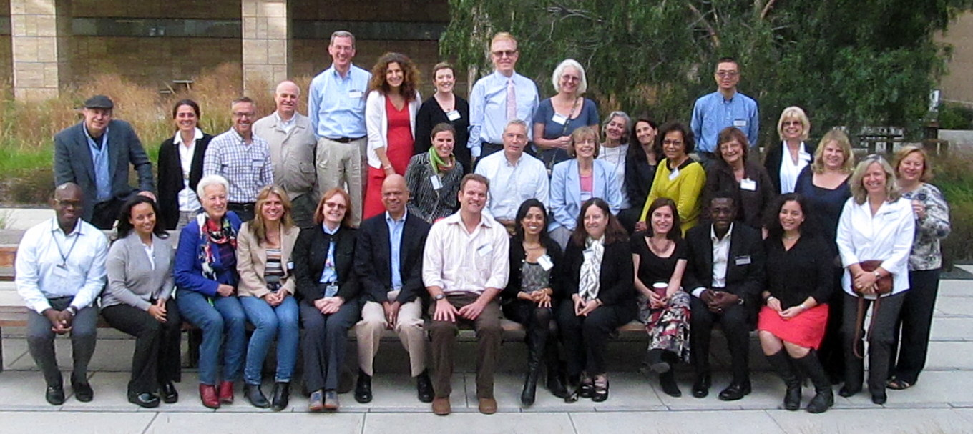
October 7-8, 2013; UCSF, San Francisco, CA; 32 participants, 15 institutions
Albert Einstein, UCSF, Harvard, Univ. of Washington, UAB, Emory, Georgetown, Univ. of Mississippi, UT Health, Case Western, UCLA, Johns Hopkins, Duke, Brown University, SF Dept. of Public Health

Slide 34
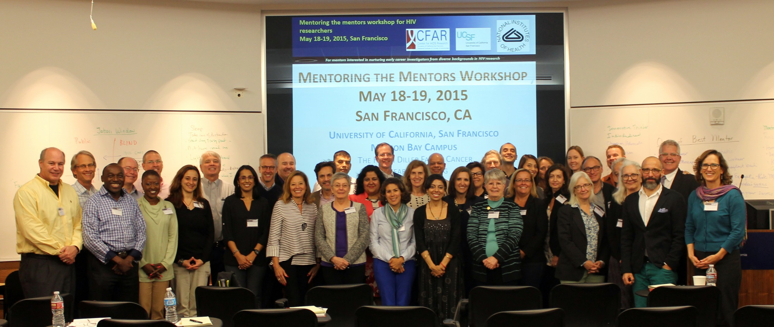
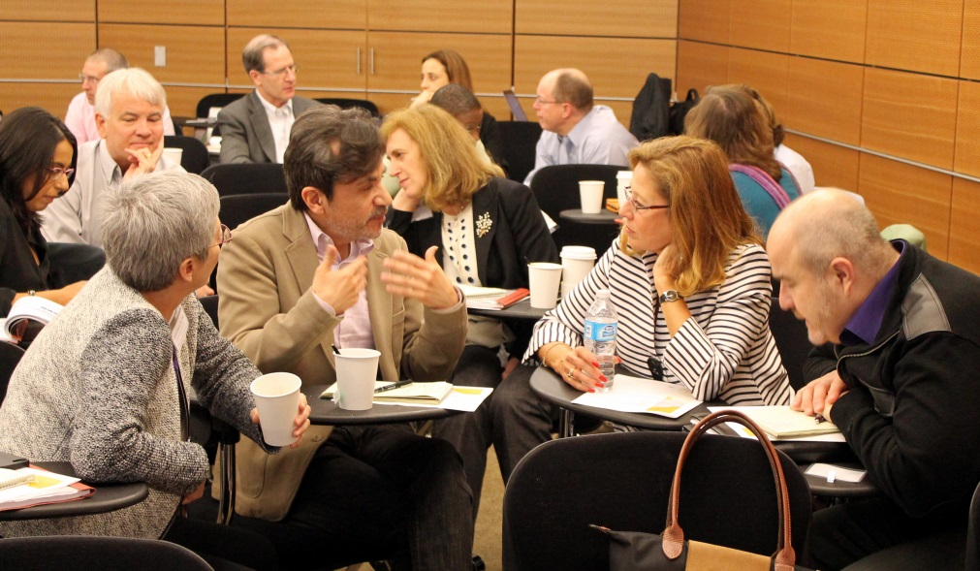
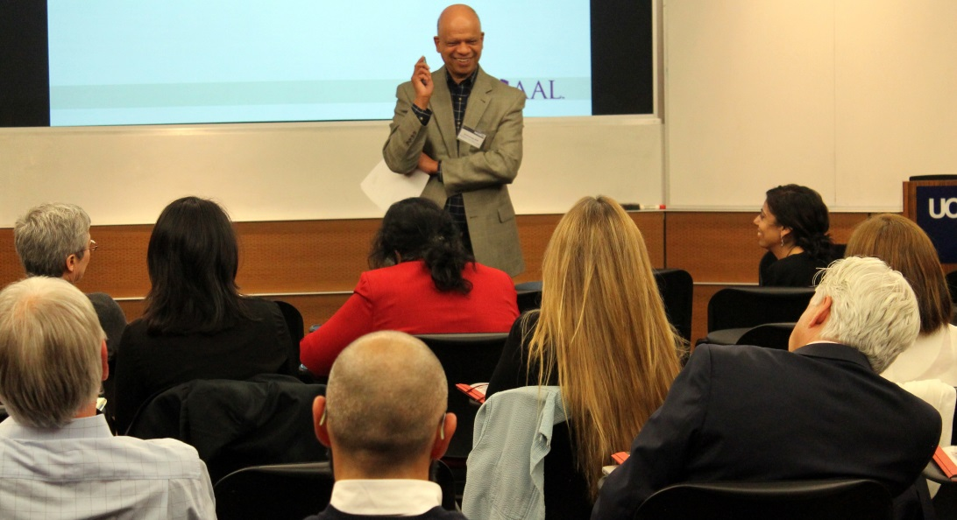

Slide 35
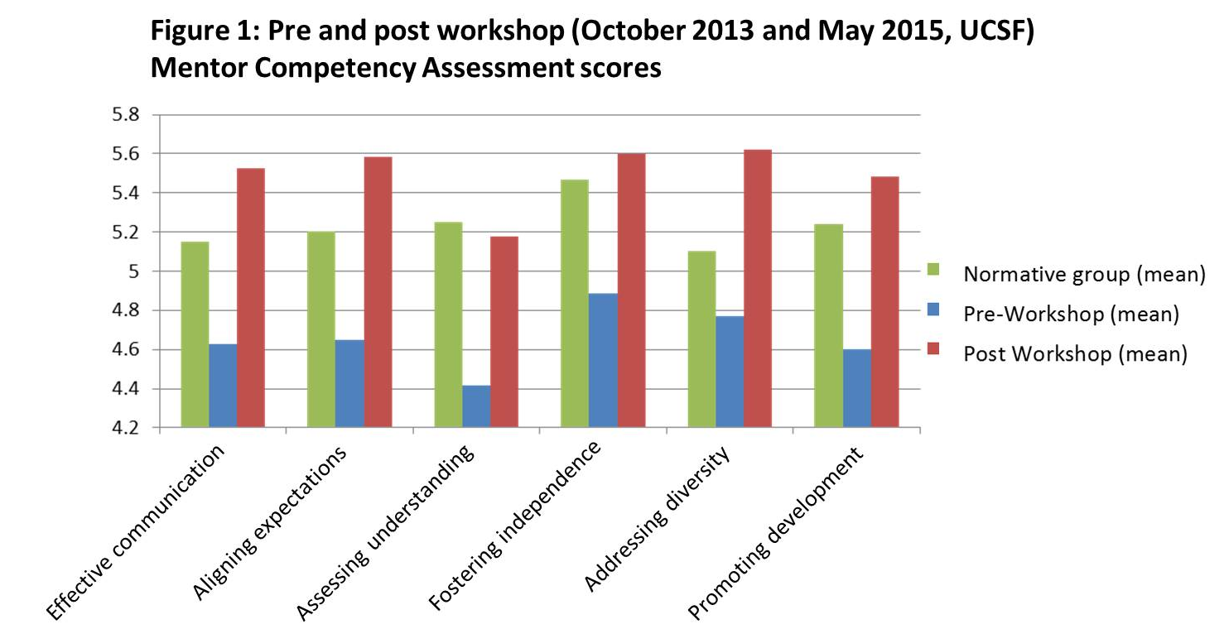
Mentoring competencies increased after workshop training
Johnson MO, Gandhi M. Advances in Health Sciences Education 2015.
Gandhi M, Johnson MO. AIDS and Behavior 2015.

Slide 36
Representation of Women in Academic Medicine, 2011-2012
Representation of Women (%)
AAMC Women in US Academic Medicine Statistics and Benchmarking Report, 2011-2012

Slide 37
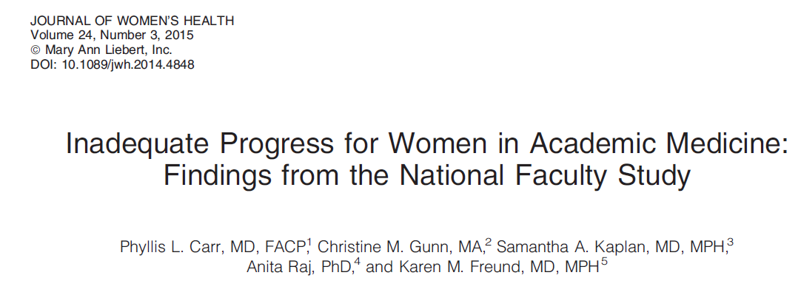
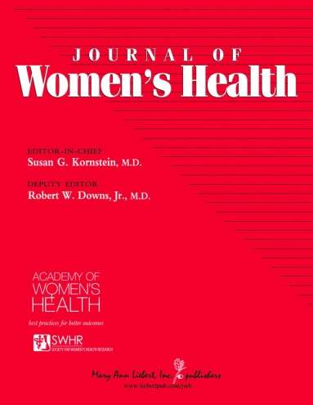
AAMC National Faculty Survey – 5 major themes:
Perceived wide spectrum in current gender climate
Lack of parity in rank and leadership by gender
Lack of retention of women in academic medicine (the ‘‘leaky pipeline’’)
Lack of gender equity in compensation
Disproportionate burden of family responsibilities and work-life balance on women’s career progression

Slide 38
Rewards of being a good mentor
Achieve satisfaction
For some mentors, their greatest joy is having a mentee succeed and eventually become a friend and colleague.
Attract good colleagues
The best mentors are most likely to be able to recruit -and keep - colleagues of high caliber who can help produce better research, papers, grant proposals, and health for the population.
Stay on top of your field
There is no better way to keep sharp professionally than to coach junior colleagues.
Develop your professional network
In making contacts for your mentee, you strengthen your own contacts and make new ones.
Extend your contribution
The results of good mentoring live after you, as new continue to contribute even after you have retired.
Handelsman J. Entering Mentoring: A Seminar to train a new generation of scientists. 2009.

Slide 39
Questions?

