Slide 1
UCSF Center for AIDS Prevention Studies (CAPS) Division of Prevention Science Department of Medicine
Marguerita Lightfoot, PhD | Director
Susan Kegeles, PhD | Co-Director
Mallory Johnson, PhD | Co-Director

Slide 2
UCSF
School of Pharmacy
School of Medicine
School of Nursing
School of Dentistry
Department of Medicine
27 other Departments
Division of Prevention Science
Chief: Lightfoot
15 other Divisions
Including Division of HIV/AIDS
Center for AIDS Prevention Studies (CAPS)
Director: Lightfoot
UCSF Prevention Research Center
Director: Lightfoot

Slide 3
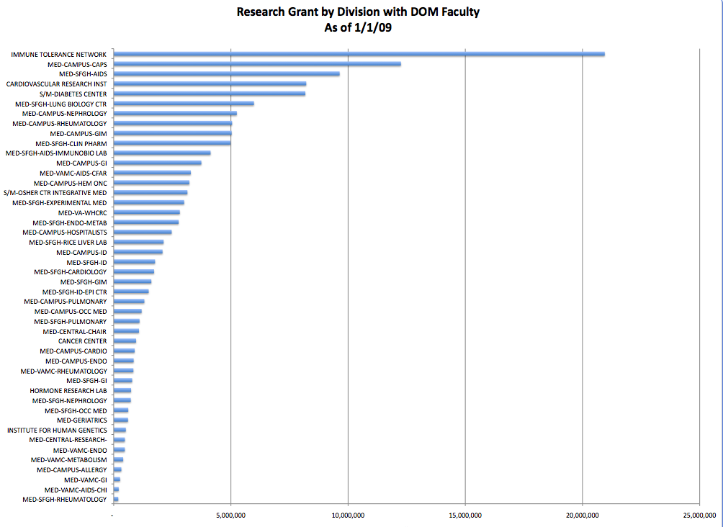
UCSF is the largest recipient of NIH funding of Departments of Medicine.
Division of Prevention Science is the largest recipient of NIH funding of the 16 Divisions in the Department.
Prevention Science faculty are 4% of the Department of Medicine but account for 16% of NIH funding.

Slide 4
Division of Prevention Science Faculty
Professor (12)
Stephen F. Morin, PhD, Emeritus
Susan M. Kegeles, PhD
Kyung-Hee Choi, PhD, MPH
Marguerita Lightfoot, PhD
William J. Woods, PhD
Diane Binson, PhD, Emeritus
Edwin Charlebois, PhD, MPH
Mallory O. Johnson, PhD
Maria Ekstrand, PhD
Torsten Neilands, PhD
Judy Auerbach, PhD
Janet Myers, PhD, MPH
Associate Professor (6)
Jae Sevelius, PhD
Tim Lane, PhD, MPH
Emily Arnold, PhD, MPH
Wayne Steward, PhD, MPH
Starley Shade, PhD
Hong-Ha Truong, PhD, MS, MPH
Assistant Professor (9)
Nicolas M. Sheon, PhD
Greg Rebchook, PhD
Sheri Lippman, PhD, MPH
Parya Saberi, Pharm.D.
Mi-Suk Kang Dufour, PhD, MPH
Amy Conroy, PhD
John Sauceda, PhD
Judy Tan, PhD
Will Vincent, PhD

Slide 5
Mission
The mission of the Center for AIDS Prevention Studies is to end the HIV epidemic and associated health and social disparities by conducting
high impact HIV prevention science and building capacity among researchers and communities to effectively address HIV.

Slide 6
Established in 1986
Innovative Research
Administrative Core
Development Core
Intervention & Implementa-tion Science Core
Methods Core
Community Engagement Core

Slide 7
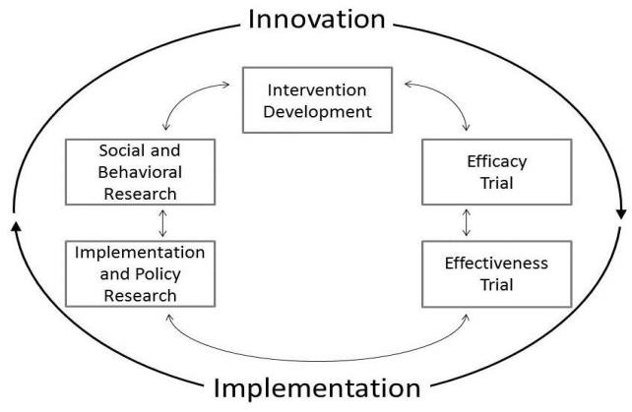
I & I Core Spectrum of HIV Intervention Science
Notes:
- Explain the Spectrum. Heuristic depiction of the complete spectrum of intervention and implementation science, as they pertain to HIV prevention
Then distribute a copy of the spectrum to people at the 4 different places/tables in room and ask them to find themselves on the image and put down arrows to indicate it.
Please focus on one of your projects, perhaps your most near-&-dear project currently. Or you can put several projects on the figure.
Talk with the group about what they are currently doing; where they think their research mostly lays on Spectrum; and why they are doing research on that.
After they talk for a bit, ask them to identify what they would want to learn more about within their current area. Are there issues, topics, methods, research design issues that they would like to know more about? There are green note cards to write your thoughts on as they come up.

Slide 8
Training Programs
Traineeship in AIDS Prevention Studies (TAPS)
The Visiting Professors Program
International Traineeships in AIDS Prevention Studies (I-TAPS)

Slide 9
CAPS RESEARCH
Gay men, MSM and MSMW
Populations experiencing disparities
International
Policy research
PrEP
Implementation science
Intervention development research, including formative research
HIV+ and the continuum of care
Incarcerated/formerly incarcerated
Heterosexual men and women
Transgender men and women
Youth
Technical assistance and capacity building
Both community and clinic-based research
Both gay and straight couples

Slide 10
CAPS Research
Susan M. Kegeles, PhD - Professor
CAPS Co-Director (MSM, young MSM, trans)
National & International Research with: Gay men, African American MSM and MSM/W, transgender persons, community-based organizations
Community-Level HIV Prevention Intervention for young black MSM
Implementation research
Community Mobilization about Continuum of Care among Young Black MSM
Marguerita Lightfoot, PhD – Professor,
CAPS Director (Adolescents & technology)
Populations: Adolescents, youth, community based participatory research
HIV Prevention Research in Minority Communities
Technology to connect at-risk youth to testing

Slide 11
CAPS Research
Edwin Charlebois, PhD, MPH - Professor
Populations: Gay men, PLWH
Area: US, Uganda
Structural Alcohol/HIV Risk Intervention in Gay Bar Patron
Project Promote: Novel Strategies to Prevent Malaria and Improve HIV Outcomes in Africa – Data and Statistics Core
Family-Based HIV VCT for Patients at Risk for TB
Modeling the Impact of Ryan White Care Act Severity of Need Indices
Kyung-Hee Choi, PhD, MPH - Professor
Populations: MSM
Area: US, China
Social/Sexual Networks & HIV Risk: Men of Color
CHATS: Developing a Network Intervention to Promote Women’s Health
Developing a Network-based HIV Prevention Intervention for MSM in
China

Slide 12
CAPS Research
Maria Ekstrand, PhD - Professor
Populations: MSM, women, sex workers, migrant workers, HIV+ persons
Area: India
Examining ART adherence issues in Bangalore, India
AIDS stigma and gender: Health consequences in urban India
Contexts and correlates of health behaviors in South India

Slide 13
CAPS Research
Mallory Johnson, PhD - Professor
Populations: HIV+ persons, couples, mentoring
Area: US, South Africa
Duo Project: Relationship factors and HIV treatment adherence
The PATH Project: A Randomized Controlled Trial Preparing Patients to Start Antiretroviral Therapy
Mi-Suk Kang-Dufour, PhD, MPH - Assistant Professor
Populations: MSM, incarcerated adults, African American
Linkages to care among HIV+ persons coming out of prison
HIV testing, linkage to care and PrEP among MSM of color

Slide 14
CAPS Research
Tim Lane, PhD, MPH - Associate Professor
Populations: MSM, healthcare providers, MSM in Africa
HIV Prevention among Township Men Who Have Sex with Men in South
Africa
MSM Community Mobilization for HIV Research
Sheri Lippman, PhD, MPH - Assistant Professor
Populations: Heterosexual women, MSM of color
Effects of cash transfer and community mobilization in young South
African women
Understanding Community Mobilization for HIV Prevention in the African
Context
Assessing the feasibility of conducting a randomized community trial of the
Encontros intervention model among sex workers in Brazil

Slide 15
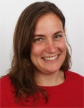
CAPS Research
Janet Myers, PhD, MPH - Professor
Populations: healthcare providers, HIV+ persons, NGOs
Area: Caribbean, Ukraine
Evaluation of patient perspectives on routing HIV screening in health care settings
Strengthening capacity to deliver HIV research counseling and testing in international biomedical prevention and treatment trials
Implementation science/HRSA SPNS projects
Tor Neilands - Professor
Director, Methods Core
Quantitative data analysis methods and survey scale development
Fostering and conducting behavioral HIV/AIDS-prevention research in racial and ethnicity minority populations and communities
Advanced quantitative methodological, statistical, and data analytic support for epidemiological and behavioral HIV prevention research efforts.

Slide 16
CAPS Research
Greg Rebchook, PhD - Assistant Professor
Populations: MSM, African American, Transwomen
Co-Director, Technology and Information Exchange Core (TIE Core)
Capacity Building Assistance (CBA) to Assist CBOs
Moving a Research-Based Intervention into Practice
Research to evaluate an effective community-level intervention adapted for Black MSM
Implementation science, HRSA SPNS
Parya Saberi, PharmD, MAS - Assistant Professor
Technology-based Adaptive Treatment Strategies for Antiretroviral Adherence
Social Networking Technologies in Improving Treatment Engagement of Young Black HIV+ Individuals
HIV and Aging

Slide 17
CAPS Research
Jae Sevelius, PhD - Associate Professor
Populations: Transgender, HIV+ persons,
Co-Principal Investigator of the UCSF Center of Excellence
Sheroes / Sheros Plus Projects – An intervention to reduce risk taking behaviors among HIV-positive and negative transwomen.
T-Sista – A research collaboration with San Francisco’s Asian Pacific Islander Wellness Center which is an adaptation of the SISTA project, a social-skills training intervention aimed at reducing HIV sexual risk behavior among high risk African American transwomen.
Starley Shade, PhD - Assistant Professor
Populations: healthcare providers
Application of Weighted Time-series to Address Bias in Evaluation of Clinic- and Community-level Research
PI for a CDC cooperative agreement to provide technical assistance, capacity building and organizational development in Mozambique
Implementation science, SPNS

Slide 18
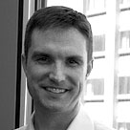
CAPS Research
Nicholas Sheon, PhD - Assistant Professor (Qualitative Methods Core)
Populations: MSM, HIV+ persons
IMPACT (Investigating Motivations for Participation in Anal Cancer Prevention Trials)
A Structural Intervention to Improve HIV Test Counseling
Using technology to streamline client data collection and improve HIV test counseling
Wayne Steward, PhD, MPH – Associate Professor
Populations: policy, gay men, HIV+ persons, policymakers, CBOs
Heading up a policy research center for state of CA
Severity of need: California health care financing and policy research initiative
Implementation science (HRSA SPNS)

Slide 19
CAPS Research
Hong-Ha Truong, PhD, MS, MPH - Associate
Professor
Populations: gay men
Area: Vietnam, Zimbabwe
International Travel Research to Inform Prevention (I-TRIP)
Monitoring Resistance During Rapid Expansion of Antiretroviral Therapy
Bill Woods, PhD - Professor
Populations: MSM/F, substance users (Bathhouses)
Vice Chair, UCSF IRB
CAPS Visiting Professor Program
Systems Linkage and Access to Care initiative (SLAC)

Slide 20
CAPS Research
Emily Arnold, PhD, MPH - Associate Professor
Populations: MSM, African American, faith communities (Black gay youth, Ball room community)
BRUTHAS Randomized Control Study
The Ballroom Community Project: Social Networks and Social Support
among High Risk African American Men
Faith-based HIV Prevention for Black MSM in California

Slide 21
International Research Sites
Antigua and Barbuda
Argentina
Barbados
Botswana
Brazil
Burkina Faso
Cambodia
Chile
China
Colombia
Croatia
Dominican Republic
Ecuador
Georgia
Guatemala
Haiti
India
Indonesia
Iran
Japan
Kazakhstan
Kenya
Malawi
Morocco
Mexico
Morocco
Myanmar
Nepal
Namibia
Nepal
Nigeria
Peru
Philippines
Russia
St. Kitts and Nevis
St. Vincent and the Grenadines
South Africa
Tanzania
Thailand
Trinidad & Tobago
Uganda
Ukraine
Venezuela
Vietnam
Zimbabwe

Slide 22
Thank You!

