Slide 1
Clinic-based Translational Research
Cohort/
Clinical Trial
Immunology Core Lab
(Sinclair)
Basic Immunology Lab
(McCune)
Virology
Core Lab
(Liegler)
Basic Virology Lab
(Wong)
GI
(Somsouk)
Cardiology
(Hsue)
Neurology
(Price)

Slide 2
Productivity Mostly Attributable to Data and Biological Specimens from the Cohorts
 | SCOPE | UARTO | ISS Clinic
No. of subjects | 1938 | 750 | 22,087
Location | San Francisco | Mbarara, Uganda | Mbarara, Uganda
Cohort type | Dynamic | Fixed | Dynamic
Entry Criteria | Demand-driven collection of both prototypical & rare clinical phenotypes | Consecutive ART starters at a prototypical municipal ART clinic | All patients at a prototypical municipal ART clinic
Paper-based measurements | Research-dedicated | Research-dedicated | During course of clinical care
Biologic specimens | Serum, plasma, PBMCs, saliva | Serum, plasma, PBMCs, saliva | --
Follow-up | 4 months | 4 months | Clinically-driven
Special procedures | Gut & lymph node biopsies, apheresis | Real time adherence monitoring | Active tracking of drop outs
Notes:
The productivity of the Core is mostly attributable to the data and biological specimens that are derived from the supported cohorts.

Slide 3
Clinical Cohorts
SCOPE: Chronically HIV-infected patients
Enriched for “extreme phenotypes” (elite controllers, viremic non-progressors, immunologic non-responders, etc).
Key Faculty: Steve Deeks, Jeff Martin, Peter Hunt, Hiroyu Hatano
OPTIONS: Recently/Acutely HIV-infected patients
Boutique Cohorts: Transmission pairs, Highly exposed HIV-uninfected patients
Key Faculty: Rick Hecht, Chris Pilcher
WIHS: Multi-center cohort of HIV-infected women and risk-matched HIV-negative controls
Key Faculty: Ruth Greenblatt, Monica Gandhi, Phyllis Tien

Slide 4
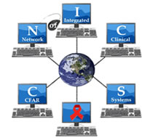
Domestic Cohort Linkages
Notes:
Our cohorts not only provide data and specimens themselves to CFAR users but also are linked to larger networks and thus give CFAR users broader opportunities. Specifically, ….

Slide 5
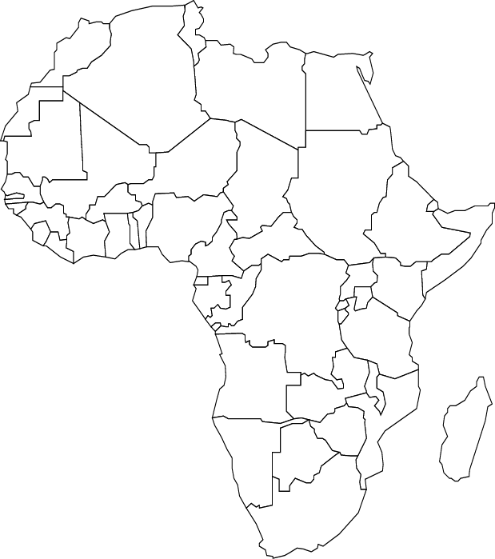
International Cohort Linkages
Central Africa
ISS Clinic Cohort
UARTO
Notes:
Internationally, there is similar nesting and linkage.

Slide 6
Other Research Networks
ACTG (AIDS Clinical Trials Group)
Marion Peters (Hepatitis TSG Chair)
Diane Havlir (TB TSG Vice Chair)
Peter Hunt (Inflammation/End-organ Disease Vice Chair)
CNICS (CFAR Network of Integrated Clinical Systems)
Linked electronic medical records across multiple HIV clinics
Specimens available to link biomarkers to rare clinical outcomes
Key Faculty: Elvin Geng, Steve Deeks, Peter Hunt, Jeff Martin

Slide 7
Core Metrics: 2012-2013
Item | Number
Projects
Total | 144
International | 33
Users
Total | 205
UCSF CFAR | 69
Other CFARs | 57
Non-CFAR | 79
Early Stage Investigators | 38
Publications* | 60
Conference Presentations | 58
* including submitted
Notes:
And, in brief, some of the important metrics of the Core.

Slide 8
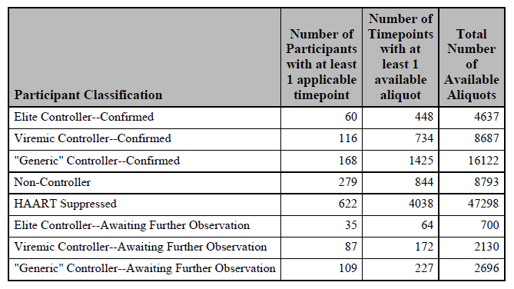
Real time inventory
Rapid distribution
Specimen Type | No. Unique Timepoints
Plasma | 2080
Serum | 450
Viable PBMC | 947
Non-viable PBMC | 768
2012:
48 separate specimen shipments to investigators

Slide 9
Innovation: Linkage to CNICS Specimen Repository
March 25, 1987 to present
8 contributing sites
CWRU - Fenway
JHU - UAB
UCSD - UCSF
UNC - UW
661,880 aliquots
- from 77,819 unique timepoints
-- from 11,414 HIV-infected patients
Notes:
9

