Slide 2
CFAR Mentoring Unconscious Bias Workshop

Slide 3
Agenda
Welcome
The problem of unconscious bias
Blocking bias --solutions and tips
Wrap up & Take away points

Slide 4
What is Bias?
A quick judgment that is:
Hidden
Automatic
Natural
Notes:
READ the definition on the slide, and check for understanding. REINFORCE that this is not about values, morality, or character.
Before clicking to the next slide, you might SAY, “Now, let’s take a look at what bias looks like when it happens.”

Slide 5
What function does bias serve?
Helps us to create meaning out of what we observe
Provides mental shortcuts
Screens out information so that we can concentrate on what we choose to focus on
Keeps us alive
Notes:
Before showing the bullets, ASK the question, “So why do we have bias? It must serve us, somehow. What does bias do for us?”
You might receive responses such as “safety” or “quick decisions.”
Then, REVEAL the bullet points, and discuss each briefly. It is helpful to prepare an example for each one, in case there are questions. You could share one of your examples, just as an engagement tool.

Slide 6
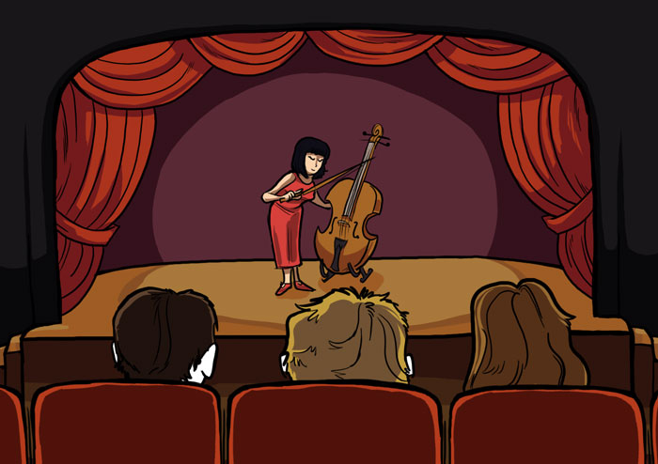
Goldin & Rouse 2000

Slide 7
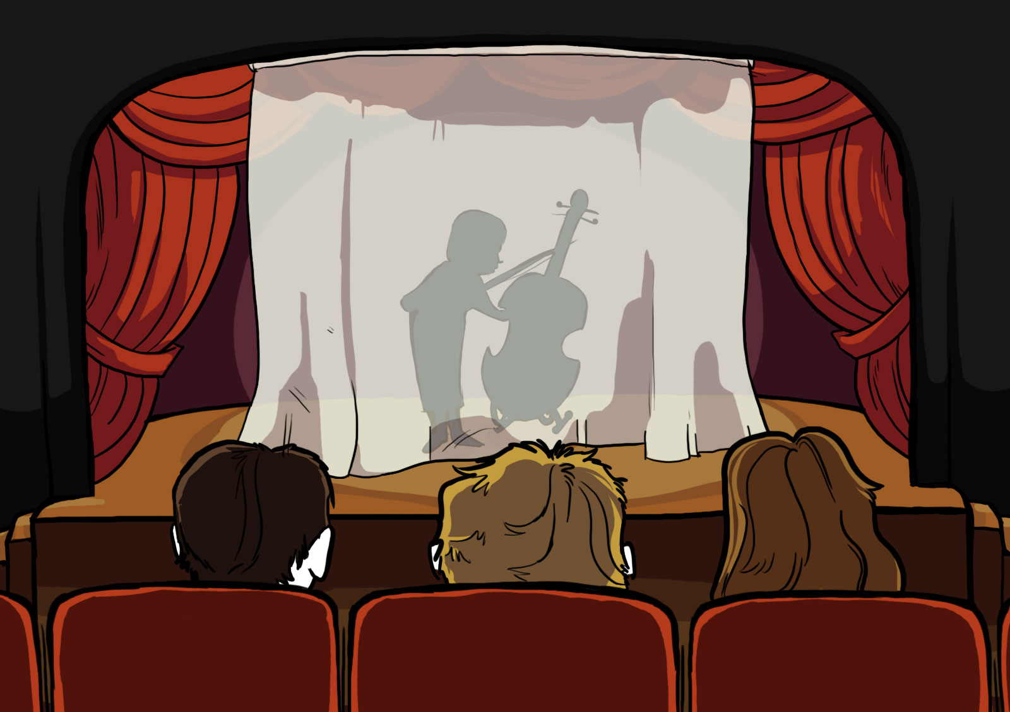
Goldin & Rouse 2000

Slide 8
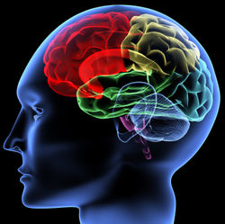
System Two Thinking
“Slow Brain”
Pre-Frontal Neocortex
Perceptual awareness, thought, language, and consciousness
System One Thinking
“Fast Brain”
Anterior Cingulate Cortex
Autonomic functions, rational functions (decision-making, empathy, reaction to reward, emotion,
System One Thinking
“Fast Brain”
Amygdala/
”Reptilian Brain”
Processing and memory of emotional reactions, especially fear
Notes:
NOTE that much of this work is based on neuroscience, and that we’ve learned more about the brain in the 21st century than we’ve known throughout history.
Talk through the various parts of the brain, then REVEAL the “System One/Fast Brain” and “System Two/Slow Brain” boxes.
The language of System One and System Two comes from Daniel Kahneman, who wrote “Thinking Fast & Slow.” The language of Fast Brain and Slow Brain can be helpful, especially in a culture that appreciates “fast” much more than “slow.” This language tells us that one of the most important ways to mitigate the negative effects of bias is to slow down (in a world that often encourages us to speed up).

Slide 9
“Fast Brain” vs. “Slow Brain”
The power of bias is due to the ways in which our “fast brain” governs our every day lives
We make associations very quickly, based on our experience or beliefs, and more slowly when we see something counter to our experience or beliefs
We tend to do things we know how to do or are used to because it takes less brain power.
Notes:
TALK THROUGH the bullets on the slide.
NOTE that one way to distinguish between a “bias” and other kinds of decisions we make is that biases always happen in less than a second. If you have to think through a set of data to reach a conclusion, you’re already using your pre-frontal neocortex to do so.

Slide 10
SLB | CFLTK | CFLTK
SPRND | HLMG | CFLTK
SLB | SPRND | SLB
SPRND | HLMG | CFLTK
HLMG | SPRND | CFLTK
John Ridley Stroop, 1935
Notes:
INTRODUCE the “Stroop Test” experience, a way to feel your fast brain and your slow brain working at once.
SAY, “This is the Stroop Test, developed by a man named John Ridley Stroop in 1935. It was originally designed to test memory functions, but it also tells us something very profound about the ways our fast brains and slow brains work. I’m about to reveal some text in each one of the boxes you see here, and when I do, I’d like you to shout out the color of the letters you see. So for instance, when I reveal the first box (click), you say …”
Participants will respond, “Green.”
SAY, “And when I reveal the next box (click), you say …”
Participants will respond, “Blue.”
SAY, “Great. Now I’m going to reveal the rest of the boxes, one by one, at a rate of about one per second; let’s see how we do.”
CLICK THROUGH the boxes. At the end of the experience, COMMENT on their performance. NOTE that you’re going to conduct the test a second time, and that we’ll try to do better (or just as well) the next time through.

Slide 11
RED | GREEN | YELLOW
BLUE | GREEN | BROWN
RED | YELLOW | BLUE
BROWN | BROWN | BLUE
YELLOW | GREEN | RED
John Ridley Stroop, 1935
Notes:
This time, simply CLICK THROUGH the entire test (go at the same pace as before).
You may receive a lot of laughter this time through, and often a small group of people determined to do the test just as well the second time.
But this go-round is a lot more difficult. ASK why.
NOTE that in the second experience, the fast brain and slow brain were at odds with one another. SAY, “When the first box was revealed, what did your fast brain say?”
Participants will answer “Red.”
SAY, “But your slow brain, your smarter brain, knew that wasn’t the answer. And it had to struggle a little bit to overcome your ‘fast brain’ response to say ‘Green.’”
NOTE that fast brains never quieted down, throughout the entire activity. Furthermore, one of the things that makes this so difficult is the speed with which you clicked through the test. Had you slowed down, the slow brain would have had more time to dismiss the messages from the fast brain.

Slide 12
Add These Numbers

Slide 13
Add These Numbers
1000

Slide 14
Add These Numbers
1000
40

Slide 15
Add These Numbers
1000
40
1000

Slide 16
Add These Numbers
1000
40
1000
30

Slide 17
Add These Numbers
1000
40
1000
30
1000

Slide 18
Add These Numbers
1000
40
1000
30
1000
20

Slide 19
Add These Numbers
1000
40
1000
30
1000
20
1000

Slide 20
Add These Numbers
1000
40
1000
30
1000
20
1000
10

Slide 21
Add These Numbers
1000
40
1000
30
1000
20
1000
10
= 4100

